Slide 1




University Institute of Engineering
Department of Computer Science & Engineering
COMPUTER ORGANIZATION & ARCHITECTURE
(23CST-204/23ITT-204)
ER. SHIKHA ATWAL
E11186
ASSISTANT PROFESSOR
BE-CSE

Slide 2
TYPES OF MEMORY
Memory is major part of computers that categories into several types. Memory is best storage part to the computer users to save information, programs and etc. The computer memory offer several kinds of storage media some of them can store data temporarily and some them can store permanently. Memory consists of instructions and the data saved into computer through Central Processing Unit (CPU).
1. Primary Memory
Also known as main memory in the computer, it communicates directly with the CPU, cache and auxiliary memory. It allows immediate access from temporary memory slots or other storage locations. This type of computer memory keeps data and programs when the process is active to use them.

Slide 3
When a program or data is activated for execution, the processor loads instructions from the secondary memory into the main memory and then starts execution. It is a volatile memory due to which any unsaved data is lost when a power cut occurs. Primary memory is of two types: RAM and ROM.
1.1 RAM
RAM is hardware that temporarily stores data and programs. It is the faster part of the main memory which can be directly accessed by the CPU. It reads and writes programs until the computer is switched on. RAM is of two types: DRAM and SRAM.

Slide 4
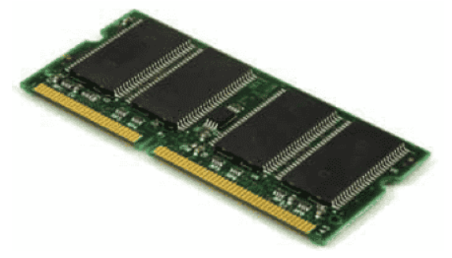
DRAM (Dynamic Random-Access Memory): It is a type of RAM that is used for dynamic data storage. Every cell in DRAM consists of one-bit information. A cell is composed of a transistor and a capacitor. This capacitor and transistor are extremely small in size. The capacitor needs a continuous refresh to retain information since it is volatile.

Slide 5
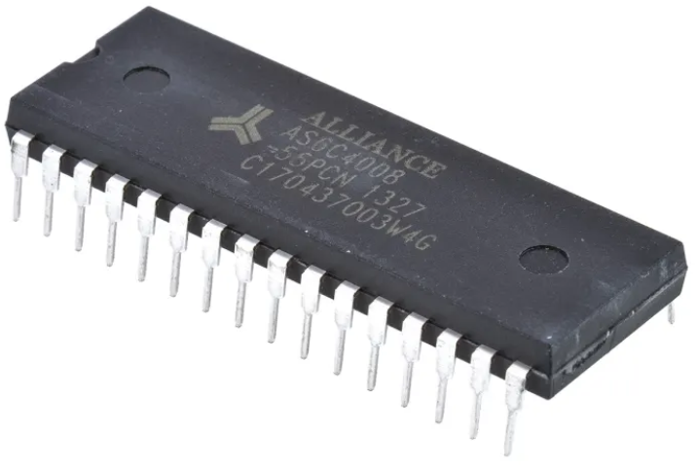
SRAM (Static Random-Access Memory): This type of RAM stores static data in memory which remains active until there is a power supply. Same sized SRAM chip holds less data than DRAM. Unlike DRAM, it does not require a continuous refresh.

Slide 6
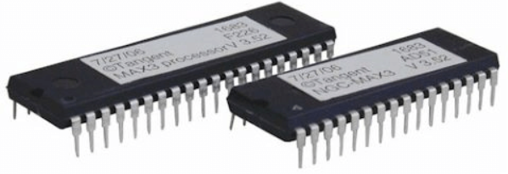
1.2 ROM
Read-Only Memory (ROM) is a permanent storage type. This is a type of read-only memory that only reads the stored information, but it does not have the capability to modify or write. Since it is a non-volatile type of memory in computer, the information stays even after a power cut or when the system has been shut down.

Slide 7
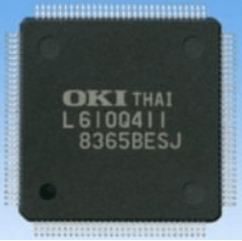
ROM is of the following five types:
MROM (Mask Read Only Memory): It is the oldest ROM whose data is pre- configured via integrated circuit manufacture during the time of manufacturing. It has become obsolete so it is not used anywhere in today's world. Due to this pre-configuration, the user cannot change the instruction stored within the MROM chip. It cannot be modified, reprogrammed, or erased later.

Slide 8
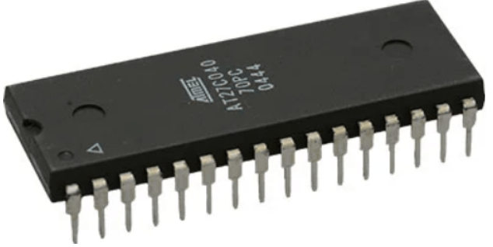
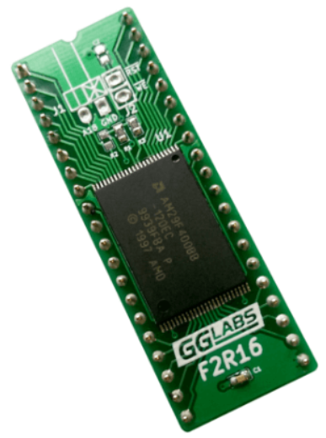
PROM (Programmable Read Only Memory): It is a digital ROM which only once allows writing any information or program. This is done using a special PROM programmer or burner device.
Flash ROM: This type of ROM can be programmed or written in smaller units called sectors or block. It is used for transferring data between computer and digital devices.

Slide 9
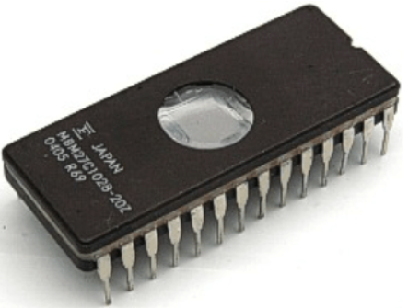
EPROM (Erasable Programmable Read Only Memory): In this type of ROM, data can be erased as well as reprogrammed only once. It can store data for a minimum of 10-20 years. To erase and reprogram EPROM, the user needs to pass UV light for 40 minutes. Post this, the data can be recreated.

Slide 10
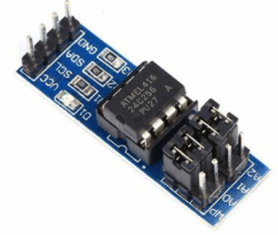
EEPROM (Electrically Erasable Programmable ROM): It is an electrically erasable and programmable ROM. This allows data to be erased using a high-voltage electrical charge. After this, it can be reprogrammed up to thousands of times.

Slide 11
Secondary Memory
It is a permanent type of memory in computer that holds a large amount of data. This is an external memory that represents different storage media on which data and programs can be saved for long term. It is not directly accessible by the CPU and is available as external devices such as CDs, DVDs and USBs. They are cheaper than primary memory but slower than primary memory.
Hard disk: It is a type of permanent computer memory that stores programs, files and data. It is stored on the motherboard of the computer that does not lose data even when there is a power outage or when the system has been switched off.
Compact Disc (CD): It is an optical disk storage device that stores different types of data, such as audio, video, files, and other information. CD uses light to read and write data from CDs.
Pen Drive: This portable device is a type of secondary memory in computer that is used for permanently storing data. It is also known as a USB flash drive that stores and transfers.

Slide 12
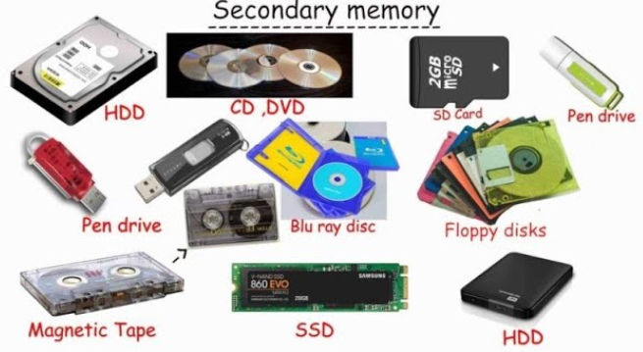

Slide 13
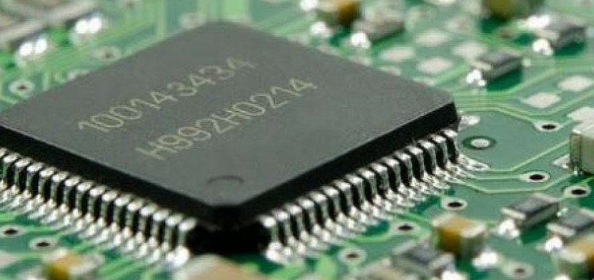
Cache Memory
This small-sized chip-based memory in computer lies between the main memory and CPU. It is very close to the chip of CPU. The aim of this type of computer memory is to enhance the performance of the CPU. It is a high-performance and temporary type of memory that reduces the access time of data from main memory. Every instruction and data that is often used by the CPU is stored within Cache memory. Cache memory is of three types: L1, L2, and L3 cache which will discussed in detail in later chapters.

Slide 14
Importance of Different Types of Memory in Computer
Different types of computer memory are essential for the computer system since, without it, the system cannot perform even basic tasks.
In a computer system, memory stores different types of data, such as audio, video, documents, images, etc.
This data can be retrieved as and when required.
The CPU selects memory cells for reading and writing data based on the task that the user wants the computer to accomplish.
There are different memory types in computers to suit the device’s needs.

Slide 15
References
Reference Books:
J.P. Hayes, “Computer Architecture and Organization”, Third Edition.
Mano, M., “Computer System Architecture”, Third Edition, Prentice Hall.
Stallings, W., “Computer Organization and Architecture”, Eighth Edition, Pearson Education.
Text Books:
Carpinelli J.D,” Computer systems organization &Architecture”, Fourth Edition, Addison Wesley.
Patterson and Hennessy, “Computer Architecture”, Fifth Edition Morgaon Kauffman.

Slide 16
Other References
https://www.studytonight.com/computer-architecture/memory-organization
https://www.ics.p.lodz.pl/~dpuchala/CompArch/Lecture_6.pdf
https://www.javatpoint.com/rom
Video References
https://www.youtube.com/watch?v=gGAMvn4vV40
https://www.youtube.com/watch?v=LI7gAVkxjAs

